Slide 1
reproducible research?
for bioinformatics projects
using git, snakemake, rmarkdown/jupyter, conda, and docker
Rasmus Ågren (rasmus.agren@scilifelab.se) & Leif Väremo (leif.varemo@scilifelab.se)
Bioinformatics long-term support (WABI),
Chalmers Computational Systems Biology Infrastructure (CSB),
National Bioinformatics Infrastructure Sweden (NBIS),
SciLifeLab
2017-04-05

Slide 2
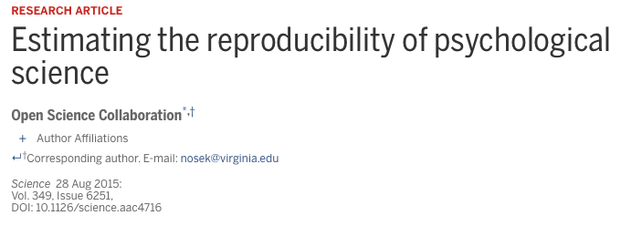
Why all the talk about
reproducible research?
The Reproducibility project set out to replicate 100 experiments published in high-impact psychology journals.
About one-half to two-thirds of the original findings could not be observed in the replication study.

Slide 3
Why all the talk about
reproducible research?
A recent survey in Nature revealed that irreproducible experiments are a problem across all domains of science¹.
Medicine is among the most affected research fields. A study in Nature found that 47 out of 53 medical research papers focused on cancer research were irreproducible².
Common features were failure to show all the data and inappropriate use of statistical tests.
[1] "1,500 scientists lift the lid on reproducibility". Nature. 533: 452–454
[2] Begley, C. G.; Ellis, L. M. (2012). "Drug development: Raise standards for preclinical cancer research". Nature. 483 (7391): 531–533.

Slide 4
Exempel, bra vs dåligt
Finns det artikel om icke-reproducerbarhet I bioinformatik?
Why all the talk about
reproducible research?
Replication of data analyses in 18 articles on microarray-based gene expression profiling published in Nature Genetics in 2005–2006:
Can reproduce…
…in principle
…with some discrepancies
Software not available
Cannot reproduce
Data not available
…from processed data with some discrepancies
Methods unclear
Different results
…partially with some discrepencies
Summary of the efforts to replicate the published analyses.
Adopted from: Ioannidis et al. Repeatability of published microarray gene expression analyses.
Nature Genetics 41 (2009) doi:10.1038/ng.295

Slide 5
What do we mean with
reproducible research?
 |  | Data
 |  | Same | Different
Code | Same | Reproducible | Replicable
 | Different | Robust | Generalisable
All parts of a bioinformatics analysis have to be reproducible:
Environment
“It takes some effort to organize your research to be reproducible. We found that although the effort seems to be directed to helping other people stand up on your shoulders, the principal beneficiary is generally the author herself. This is because time turns each one of us into another person, and by making effort to communicate with strangers, we help ourselves to communicate with our future selves.”
Schwab et al. Making scientific computations reproducible. Computing in Science Engineering (2000).
Data
Results
Source code

Slide 6

Key components
Snakemake
Versioning and collaborating on code (and some other files)
Managing dependencies
Managing and executing analysis workflow
Connecting code and reporting
Working in projects
and…
Sublime Text
Isolating and exporting environment

Slide 7
Snakemake
Versioning and collaborating on code (and some other files)
Managing dependencies
Managing and executing analysis workflow
Connecting code and reporting
Isolating and exporting environment

Slide 8
The (minimal) project repository
data/
tracked/
meta/
resources/
nontracked/
fastq/
intermediate/
bam/
filtered/
logs/
results/
source/
Snakefile
conda_env.yaml
Dockerfile
All “input” files
Should be read-only
May contain subdirectories
Files produced by analysis
Logs
Typically reports and figures, but also e.g. count tables
All source code
The workflow – using code in source/
Conda environment – manage dependencies
Docker file – creating an isolated environment

Slide 9
The (minimal) project repository
The only files needed!
The rest can always be regenerated (with one command)
data/
tracked/
meta/
resources/
nontracked/
fastq/
intermediate/
bam/
filtered/
logs/
results/
source/
Snakefile
conda_env.yaml
Dockerfile
All “input” files
Should be read-only
May contain subdirectories
Files produced by analysis
Logs
Typically reports and figures, but also e.g. count tables
All source code
The workflow – using code in source/
Conda environment – manage dependencies
Docker file – creating an isolated environment

Slide 10
The (minimal) project repository
The only files needed!
The rest can always be regenerated (with one command)
data/
tracked/
meta/
resources/
nontracked/
fastq/
intermediate/
bam/
filtered/
logs/
results/
source/
Snakefile
conda_env.yaml
Dockerfile
Problem:
We typically have a lot of big files that are necessary for the reproducibility of the analysis

Slide 11

What to do with large files?
Aim for at the start of a project to put all data directly in its final storage place and write your scripts/snakemake rules from that perspective. Supplementary data in machine readable format!
Where? Depends on the type of data. For examples, see e.g. www.nature.com/sdata/policies/repositories
Part of Git repo: Git large file storage (LFS) - based on text pointers and dedicated remote storage of large files
Github: https://git-lfs.github.com/
Bitbucket: https://www.atlassian.com/git/tutorials/git-lfs
Dedicated repositories: e.g. SRA, GEO, GenBank, UniProt etc.
Generalist repositories: e.g. Dryad, Figshare (get DOI)
What about data from public databases?
Do they archive old versions? Write your scripts to query a specific version.
Don’t trust old versions will be available? Make a local database dump (available for reproduction).
Not feasible to make a dump? Store the intermediate data needed for the analysis together with the script that generated it.

Slide 12
Snakemake
Versioning and collaborating on code (and some other files)
Managing dependencies
Managing and executing analysis workflow
Connecting code and reporting
Isolating and exporting environment

Slide 13
A problem:
Full reproducibility requires the possibility to recreate the system that was originally used to generate the results.
“CONDA is a
package, dependency, and environment manager for any language: Python, R, Scala, Java, Javascript, C/ C++, FORTRAN”

Slide 14
Package manager
Conda package: compressed tarball (system-level libraries, Python or other modules, executable programs, or other components)
Conda keeps track of the dependencies between packages and platforms
Conda packages are downloaded from remote channels
conda install -c conda-forge matplotlib
$
$
>>>
Fetching package metadata ...........
Solving package specifications: ..........
Package plan for installation in environment /Users/varemo/Applications/miniconda2/envs/test-r2:
The following packages will be downloaded:
package | build
---------------------------|-----------------
sqlite-3.13.0 | 1 1.4 MB conda-forge
libpng-1.6.24 | 0 338 KB conda-forge
python-2.7.12 | 1 11.8 MB conda-forge
certifi-2016.8.31 | py27_0 218 KB conda-forge
freetype-2.6.3 | 1 782 KB conda-forge
functools32-3.2.3.2 | py27_1 16 KB conda-forge
numpy-1.11.1 | py27_0 3.1 MB defaults
pyparsing-2.1.8 | py27_0 89 KB conda-forge
pytz-2016.6.1 | py27_0 183 KB conda-forge
six-1.10.0 | py27_0 18 KB conda-forge
cycler-0.10.0 | py27_0 13 KB conda-forge
python-dateutil-2.5.3 | py27_0 236 KB conda-forge
setuptools-26.1.1 | py27_0 346 KB conda-forge
matplotlib-1.5.3 | np111py27_0 4.1 MB conda-forge
wheel-0.29.0 | py27_0 81 KB conda-forge
pip-8.1.2 | py27_0 1.5 MB conda-forge
------------------------------------------------------------
Total: 24.2 MB
The following NEW packages will be INSTALLED:
certifi: 2016.8.31-py27_0 conda-forge
cycler: 0.10.0-py27_0 conda-forge
freetype: 2.6.3-1 conda-forge
functools32: 3.2.3.2-py27_1 conda-forge
matplotlib: 1.5.3-np111py27_0 conda-forge
mkl: 11.3.3-0 defaults
numpy: 1.11.1-py27_0 defaults
pip: 8.1.2-py27_0 conda-forge
pyparsing: 2.1.8-py27_0 conda-forge
python: 2.7.12-1 conda-forge
Python-dateutil: 2.5.3-py27_0 conda-forge
pytz: 2016.6.1-py27_0 conda-forge
setuptools: 26.1.1-py27_0 conda-forge
six: 1.10.0-py27_0 conda-forge
sqlite: 3.13.0-1 conda-forge
wheel: 0.29.0-py27_0 conda-forge
The following packages will be UPDATED:
libpng: 1.6.17-0 r --> 1.6.24-0 conda-forge
Proceed ([y]/n)? Y
Pruning fetched packages from the cache ...
Fetching packages ...
sqlite-3.13.0- 100% |########################################################################| Time: 0:00:07 181.85 kB/s libpng-1.6.24- 100% |########################################################################| Time: 0:00:01 231.85 kB/s python-2.7.12- 100% |########################################################################| Time: 0:00:35 352.76 kB/s certifi-2016.8 100% |########################################################################| Time: 0:00:01 218.31 kB/s freetype-2.6.3 100% |########################################################################| Time: 0:00:02 380.05 kB/s functools32-3. 100% |########################################################################| Time: 0:00:00 99.19 kB/s numpy-1.11.1-p 100% |########################################################################| Time: 0:00:08 362.78 kB/s pyparsing-2.1. 100% |########################################################################| Time: 0:00:00 212.24 kB/s pytz-2016.6.1- 100% |########################################################################| Time: 0:00:00 230.51 kB/s six-1.10.0-py2 100% |########################################################################| Time: 0:00:00 79.97 kB/s cycler-0.10.0- 100% |########################################################################| Time: 0:00:00 99.54 kB/s python-dateuti 100% |########################################################################| Time: 0:00:00 327.75 kB/s setuptools-26. 100% |########################################################################| Time: 0:00:01 227.73 kB/s matplotlib-1.5 100% |########################################################################| Time: 0:00:10 422.37 kB/s wheel-0.29.0-p 100% |########################################################################| Time: 0:00:00 190.76 kB/s pip-8.1.2-py27 100% |########################################################################| Time: 0:00:03 441.97 kB/s Extracting packages ...
[ COMPLETE ]|###########################################################################################| 100%
Unlinking packages ...
[ COMPLETE ]|###########################################################################################| 100%
Linking packages ...
[ COMPLETE ]|###########################################################################################| 100%
python
import matplotlib

Slide 15
Environment manager
Conda environment: directory that contains a specific collection of conda packages that you have installed
Packages are symlinked between environments to avoid duplication
conda create --name env1 –c bioconda fastqc
fastqc --version
-bash: fastqc: command not found
source activate env1
fastqc --version
FastQC v0.11.5
source deactivate
conda create --name env2 –c bioconda python=3 snakemake
python --version
Python 2.7.12 :: Continuum Analytics, Inc.
snakemake --version
-bash: snakemake: command not found
source activate env2
python --version
Python 3.4.3 :: Continuum Analytics, Inc.
snakemake --version
3.7.1
conda env export > env2.yaml
$
$
$
$(env1)
$(env1)
$
$
$
$
$(env2)
$(env2)
$(env2)

Slide 16
Snakemake
Versioning and collaborating on code (and some other files)
Managing dependencies
Managing and executing analysis workflow
Connecting code and reporting
Isolating and exporting environment

Slide 17
A problem:
As projects grow, it becomes increasingly difficult to keep track of all the parts and how they fit together.
“Snakemake is a workflow management system that aims to reduce the complexity of creating workflows by providing a fast and comfortable execution environment, together with a clean and modern specification language in python style.”

Slide 18
Snakemake
“Normal” bottom-up approach
for sample in *.fastq
do
id=$(echo ${sample} | sed 's/.fastq//')
# Trim fastq file
echo “Trimming ${id}“
seqtk trimfq -b 5 -e 10 $sample > \
${id}.trimmed.fastq
# Compress fastq file
echo “Compressing ${id}“
gzip -c ${id}.trimmed.fastq > \
${id}.trimmed.fastq.gz
# Remove intermediate files
rm ${id}.trimmed.fastq
done
$bash trim_and_zip.sh
Trimming sample: a Compressing sample: a Trimming sample: b Compressing sample: b

Slide 19
Snakemake
$snakemake {a,b}.trimmed.fastq.gz
Provided cores: 1 Rules claiming more threads will be scaled down. Job counts: count jobs 2 gzip 2 trim_fastq 4 rule trim_fastq:
input: a.fastq
output: a.trimmed.fastq
wildcards: prefix=a 1 of 4 steps (25%) done
rule gzip:
input: a.trimmed.fastq
output: a.trimmed.fastq.gz
wildcards: prefix=a.trimmed.fastq Removing temporary output file a.trimmed.fastq. 2 of 4 steps (50%) done rule trim_fastq:
input: b.fastq
output: b.trimmed.fastq
wildcards: prefix=b 3 of 4 steps (75%) done rule gzip:
input: b.trimmed.fastq
output: b.trimmed.fastq.gz
wildcards: prefix=b.trimmed.fastq Removing temporary output file b.trimmed.fastq. 4 of 4 steps (100%) done
Snakemake top-down approach
rule trim_fastq:
input: "{prefix}.fastq"
output: temp("{prefix}.trimmed.fastq")
shell:
"seqtk trimfq -b 5 -e 10 {input} > {output}"
rule gzip:
input: "{prefix}"
output: "{prefix}.gz"
shell:
"gzip -c {input} > {output}"

Slide 20
Snakemake
import os
rule trim_fastq:
input: "{prefix}.fastq"
output: temp("{prefix}.trimmed.fastq")
params:
leftTrim=5,
rightTrim=10
log: "logs/trim_fastq.log"
version: "0.1"
message: "Trimming {input[0]}."
shadow: True
threads: 8
priority: 90
resources: mem=64
conda: "envs/seqtk.yaml"
run:
if (os.stat(input[0]).st_size > 0):
shell("seqtk trimfq -t {threads} –b {params.leftTrim}
-e {params.rightTrim} {input} > {output} 2> {log}")
else:
raise IOError(input[0]+" is empty.")

Slide 21
Snakemake
Snakemake keeps track of when files were generated and by which rules.
Here we ask for report.pdf, which is an rmarkdown report generated by the rule aggregate_reports.
Dotted rule boxes show that report.pdf already exists and that it's newer than its dependencies (recursively).
$snakemake report.pdf --dag | dot -Tpdf > dag.pdf

Slide 22
Snakemake
Forcing a rule (normExpr here) to be re-run also leads to re-running all rules which depend on it.
$snakemake -f normExpr report.pdf --dag | dot -Tpdf > dag.pdf

Slide 23
Snakemake
Here Snakemake detects that a file used in normExpr is newer than downstream files, so it re-runs the necessary rules.
$touch data/raw/ExpressionData.txt.gz
$snakemake report.pdf --dag | dot -Tpdf > dag.pdf

Slide 24
Snakemake
Things can get rather complex...

Slide 25
Snakemake
Versioning and collaborating on code (and some other files)
Managing dependencies
Managing and executing analysis workflow
Connecting code and reporting
Isolating and exporting environment

Slide 26
Some problems:
You have a figure in a Powerpoint presentation but forgot what script version and parameters were used to generate it
You realized you should alter a parameter, but this means you have to manually update all affected figures in your report or presentation

Slide 27
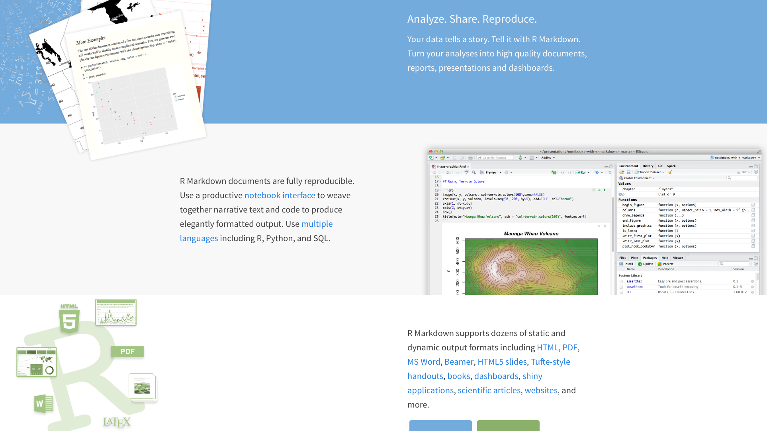

http://rmarkdown.rstudio.com/

Slide 28
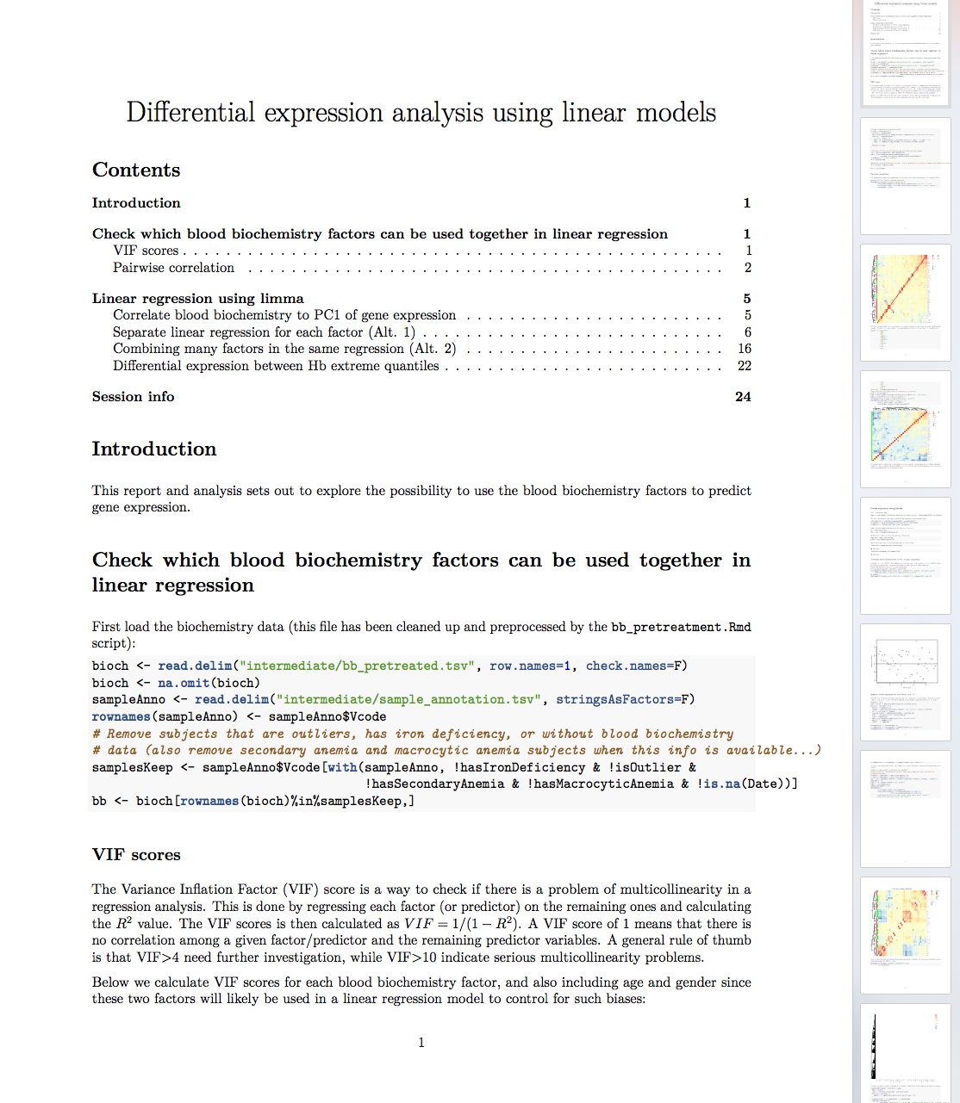
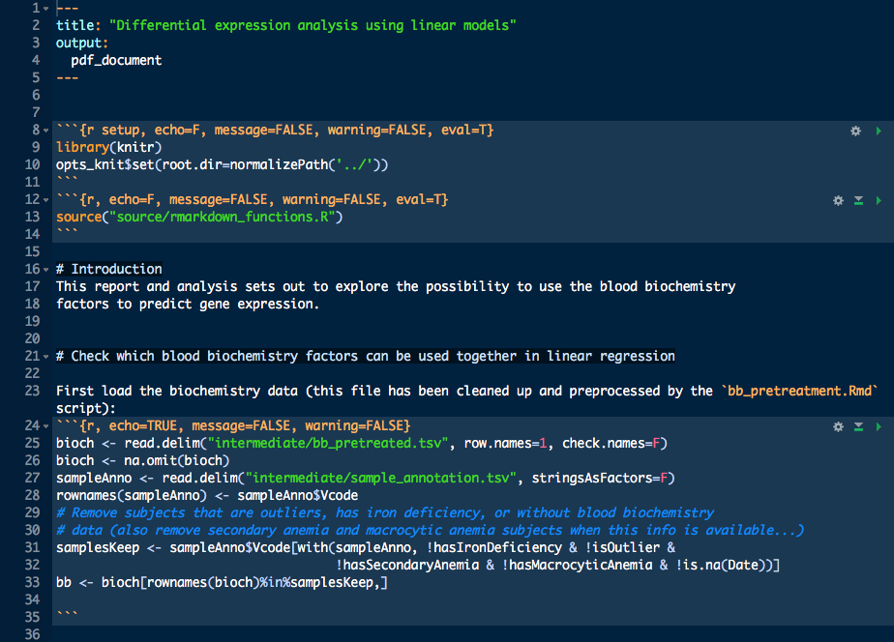

Slide 29
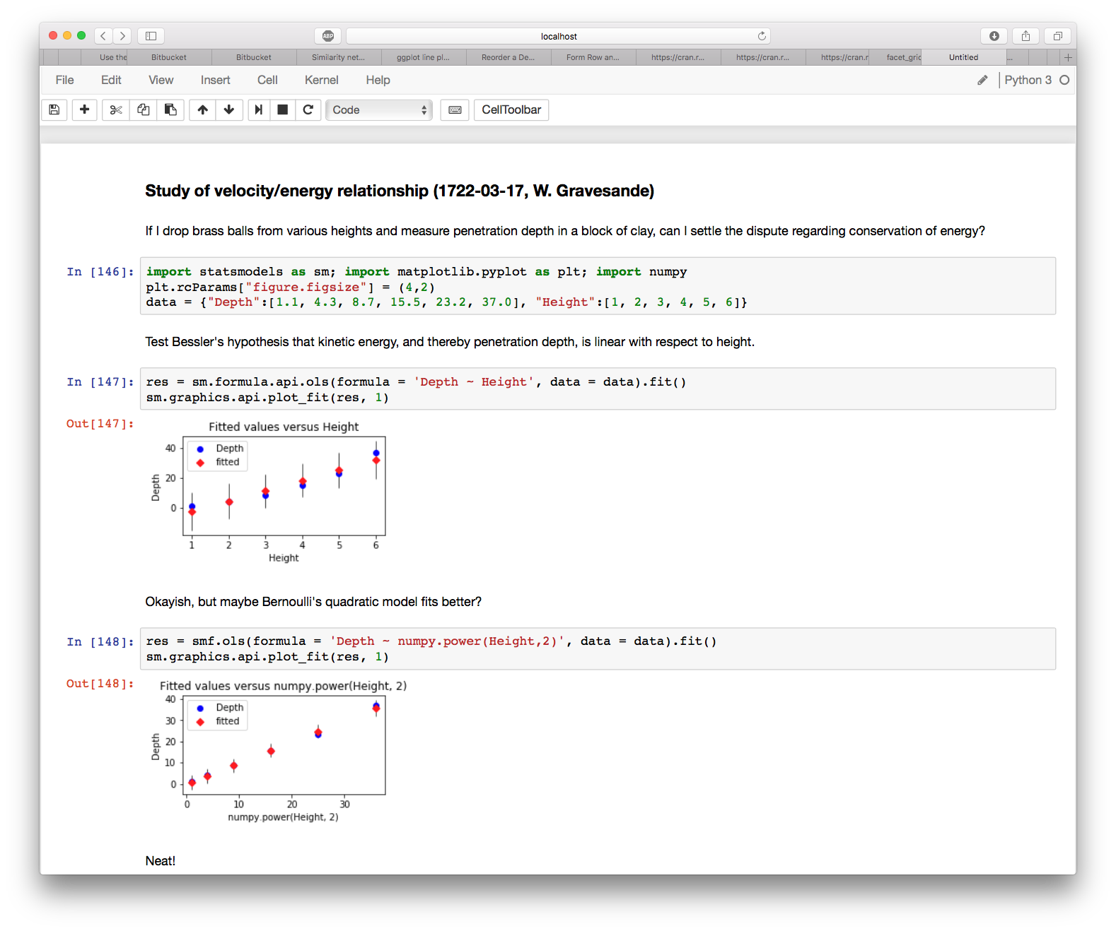
In-browser editing for code, with automatic syntax highlighting, indentation, and tab completion/introspection.
The ability to execute code from the browser, with the results of computations attached to the code which generated them.

Slide 30
Snakemake
Versioning and collaborating on code (and some other files)
Managing dependencies
Managing and executing analysis workflow
Connecting code and reporting
Isolating and exporting environment

Slide 31
A problem:
Results should be possible to reproduce regardless of platform and with minimal effort.
“Docker provides a way to run applications securely isolated in a container, packaged with all its dependencies and libraries."

Slide 32
$uname –a
Darwin dhcp-140-26.vpn.chalmers.se 15.6.0 Darwin Kernel Version 15.6.0: Thu Sep 1 15:01:16 PDT 2016; root:xnu-3248.60.11~2/RELEASE_X86_64 x86_64
$docker pull blang/busybox-bash
Using default tag: latest latest: Pulling from blang/busybox-bash a3ed95caeb02: Pull complete 77c6c00e8b61: Pull complete 61b90c8094ba: Pull complete 96b542aa9fae: Pull complete 91e17655d143: Pull complete bdd6cb71a978: Pull complete 03f992b49be8: Pull complete 87d62f6078f3: Pull complete Digest: sha256:b4675e303209bfdaeb6cad4c0c90ec3ba2cda85a75b5d965daa91bca86d0d77c Status: Downloaded newer image for blang/busybox-bash:latest
$docker run -it blang/busybox-bash / # uname -a Linux 9e8be01a6ddb 4.4.20-moby #1 SMP Thu Sep 15 12:10:20 UTC 2016 x86_64 GNU/Linux

Slide 33
$docker build -t "my_user/my_jupyter_nb" .
Sending build context to Docker daemon 22.53 kB
Step 1/7 : FROM jupyter/minimal-notebook
---> 14e926bc76a2
Step 2/7 : MAINTAINER "Rasmus Agren"
---> Running in 6bb2a51d6d1f
---> 0a4dcf315fe7
Removing intermediate container 6bb2a51d6d1f
Step 3/7 : RUN conda install matplotlib statsmodels
[...]
$docker push my_user/my_jupyter_nb
The push refers to a repository [docker.io/my_user/docker_conda]
029a889e84b1: Pushing [=> ] 1.109 MB/930.4 MB
[...]
$docker run -it --rm -p 8888:8888 my_user/my_jupyter_nb
[...]
Copy/paste this URL into your browser when you
connect for the first time, to login with a token: http://localhost:8888/?token=fcf25d2898dbc584a11a627f24232dc5432264046ff56eaa
[...]
Dockerfile
FROM jupyter/minimal-notebook
MAINTAINER "Rasmus Agren"
RUN conda install matplotlib \ statsmodels
WORKDIR /home/$NB_USER/work
ENV LC_ALL C
SHELL ["/bin/bash", "-c"]
CMD start-notebook.sh

Slide 34
Good
A great solution to the problem of dependency hell
Allows for seamlessly moving workflows across different platforms
Relatively easy to work with
Very well suited for cloud computing
The data can be packaged together with the code and environment needed to generate the results
Bad
Relies in part on the Linux kernel
Requires root access
Security issues
Has to run in VM on Windows/OS X
Quite a lot of overhead, both computationally and workwise
Made for software development, can be cumbersome when doing explorative data analysis
Docker images are rather large (>1 GB)

Slide 35
This all boils down to…

Slide 36
The onion model of reproducible research
Snakemake
Minimal: scripts for reproducible results
Good: versioned and structured repository
Better: ambition to organize dependencies
Best: export everything!

Slide 37
alternatives?
Version control | Environment / package managers | Workflow managers | Literate programming | Containerization / virtualization
Git – Widely used and a lot of tools available + GitHub. | Conda – General purpose environment and package manager. Community-hosted collections of tools at bioconda or conda-forge. | Snakemake – Based on Python, easily understandable format, relies on file names. | Jupyter – Create and share notebooks in a variety of languages and formats by using a web browser. | Docker – Used for packaging and isolating applications in containers. Dockerhub allows for convenient sharing. Requires root access.
Mercurial – Distributed model just like Git, close to sourceforge. | Pip – Package manager for Python, has a large repository at pypi. | Nextflow – Based on Groovy, uses data pipes rather than file names to construct the workflow. | Rmarkdown – Developed by Rstudio, focuses on generating high-quality documents. | Singularity – Simpler Docker alternative geared towards high performance computing. Does not require root.
Subversion – Centralized model unlike git/mercurial; no local repository on your computer and somewhat easier to use. | Apt/yum/brew – Native package managers for different OS. Integrated in OS and might deal with e.g. update notifications better. | Make – Used in software development and has been around since the 70s. Flexible but notoriously obscure syntax. | Zeppelin – Developed by Apache. Closely integrated with Spark for distributed computing and Big Data applications. | Shifter – Similar ambition as Singularity, but less focus on mobility and more on resource management.
 | Virtualenv – Environment manager used to set up semi-isolated python environments. | Galaxy - attempts to make computational biology accessible to researchers without programming experience by using a GUI. | Beaker – Newcomer based on Ipython, just as Jupyter. Has a focus on integrating multiple languages in the same notebook. | VirtualBox/VMWare – Virtualization rather than containerization. Less lightweight, but no reliance on host kernel.

Slide 38
A minimal working example…
...unless you mess up cut and pasting. If so, it might be more convenient to just
"git clone https://bitbucket.org/scilifelab-lts/reproducible_research_example.git"

Slide 39
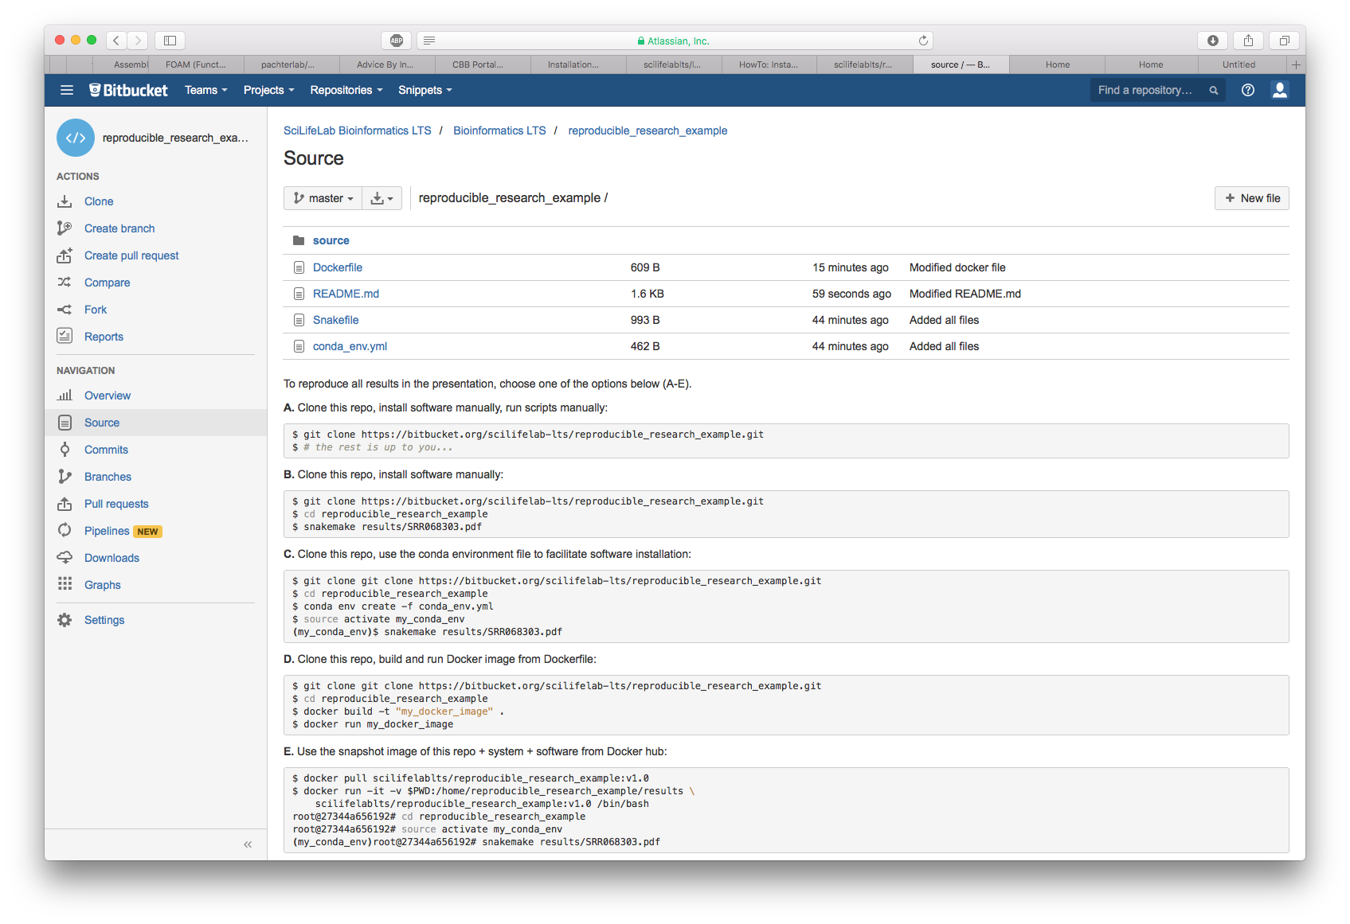
Requires user to have:
Snakemake

Slide 40
Set up git repository
Set up Conda environment
Define Snakemake workflow
Design Rmarkdown
report
Define Docker image
Push to git
Build, push and run Docker image
$git init
Initialized empty Git repository in /Users/my_user/Documents/projects/reproducible_research/.git/
# Here you should use your own account on bitbucket.org
$curl -s --user my_user https://api.bitbucket.org/1.0/repositories/ \
--data name=reproducible_research_example
Enter host password for user 'my_user':
$git remote add origin https://my_user@bitbucket.org/my_user/reproducible_research_example.git
$echo "Tutorial on reproducible research" > README.md
$git add README.md
$git commit -m "Initial commit”
[master (root-commit) b5798bd] Initial commit
1 file changed, 1 insertion(+)
create mode 100644 README.md
$git push --set-upstream origin master
Counting objects: 3, done. Writing objects: 100% (3/3), 255 bytes | 0 bytes/s, done.
Total 3 (delta 0), reused 0 (delta 0)
To https://my_user@bitbucket.org/my_user/reproducible_research_example.git
* [new branch] master -> master
Branch master set up to track remote branch master from origin.

Slide 41
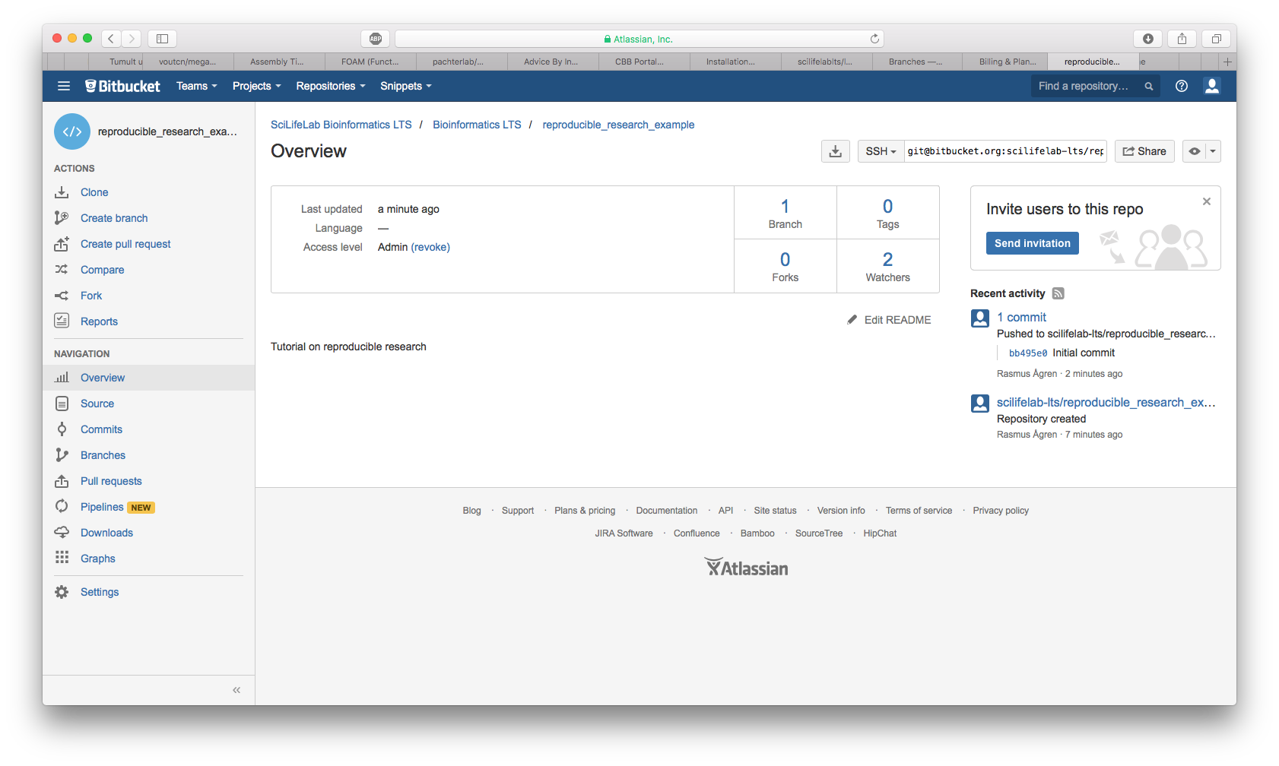
Set up git repository
Set up Conda environment
Define Snakemake workflow
Design Rmarkdown
report
Define Docker image
Push to git
Build, push and run Docker image

Slide 42
Set up git repository
Set up Conda environment
Define Snakemake workflow
Design Rmarkdown
report
Define Docker image
Push to git
Build, push and run Docker image
$conda config --add channels bioconda;conda config --add channels r
$conda create -n my_conda_env \
snakemake=3.5.5 fastqc=0.11.5 r-ggplot2=2.1.0 r-rmarkdown=0.9.6
Fetching package metadata: ........ Solving package specifications:
Package plan for installation in environment /opt/conda/envs/my_conda_env:
The following packages will be downloaded:
package | build
---------------------------|-----------------
bzip2-1.0.6 | 3 83 KB
icu-54.1 | 0 11.3 MB
java-jdk-8.0.92 | 1 122.3 MB
[...]
$source activate my_conda_env
$conda env export > conda_env.yml
$cat conda_env.yml
name: my_conda_env
dependencies:
- bzip2=1.0.6=3
- fastqc=0.11.5=1
[...]

Slide 43
Snakemake
Set up git repository
Set up Conda environment
Define Snakemake workflow
Design Rmarkdown
report
Define Docker image
Push to git
Build, push and run Docker image
Snakefile
rule get_SRA_by_accession:
output: expand("intermediate/{{sra_id}}_{dirs}.fastq.gz",dirs=["1","2"])
run:
baseDir=wildcards.sra_id[0:6]
shell("wget ftp://ftp.sra.ebi.ac.uk/vol1/fastq/"+baseDir+"/{wildcards.sra_id}/*
-P intermediate/")
rule fastQC:
input: "{prefix}.fastq.gz"
output: temp("{prefix}_fastqc.zip")
shadow: "shallow"
shell:
"fastqc {input}"
rule report:
input: expand("intermediate/{{sra_id}}_{dirs}_fastqc.zip",dirs=["1","2"])
output: "results/{sra_id}.pdf"
params:
script="source/sra_report.R"
shell:
"""
for z in {input}; do unzip $z –d intermediate; done;
echo \"library(rmarkdown);render(input = '{params.script}',output_dir = \
dirname('{output}'),output_file = basename('{output}'),params = \
list(sra_id='{wildcards.sra_id}',run_directory='../intermediate'), \
output_format = pdf_document(toc = T))\" | R --vanilla;
"""

Slide 44
Snakemake
Set up git repository
Set up Conda environment
Define Snakemake workflow
Design Rmarkdown
report
Define Docker image
Push to git
Build, push and run Docker image
$snakemake results/SRR068303.pdf -n
rule get_SRA_by_accession:
output: intermediate/SRR068303_1.fastq.gz, intermediate/SRR068303_2.fastq.gz
wildcards: sra_id=SRR068303
rule fastQC:
input: intermediate/SRR068303_2.fastq.gz
output: intermediate/SRR068303_2_fastqc.zip
wildcards: prefix=intermediate/SRR068303_2
rule fastQC:
input: intermediate/SRR068303_1.fastq.gz
output: intermediate/SRR068303_1_fastqc.zip
wildcards: prefix=intermediate/SRR068303_1
rule report:
input: intermediate/SRR068303_1_fastqc.zip, intermediate/SRR068303_2_fastqc.zip
output: report/SRR068303.pdf
wildcards: sra_id=SRR068303
Job counts:
count jobs 2 fastQC 1 get_SRA_by_accession
1 report 4
$snakemake results/SRR068303.pdf --dag | dot -Tpdf > results/dag.pdf

Slide 45
Set up git repository
Set up Conda environment
Define Snakemake workflow
Design Rmarkdown
report
Define Docker image
Push to git
Build, push and run Docker image
source/sra_report.Rmd
---
title: "Sample summary for `r params$sra_id`"
author: Rasmus Agren
date: "`r format(Sys.time(), '%d %B, %Y')`"
params:
run_directory: .
sra_id: UNKNOWN
---
#Set up
```{r, echo=T}
library(knitr)
opts_knit$set(root.dir=normalizePath(params$run_directory))
library(ggplot2)
```
#Results
```{r, echo=T}
df <- rbind(read.table(paste(params$sra_id,"_1_fastqc/summary.txt",sep=""),sep="\t"),
read.table(paste(params$sra_id,"_2_fastqc/summary.txt",sep=""),sep="\t"))
ggplot(df, aes(V3, V2)) + geom_tile(aes(fill = V1), colour = "white") +
scale_fill_manual(values=c("red", "green", "blue")) +
labs(x="",y="", fill="") + theme(text = element_text(size=8))
```
Figure 1: Summary statistics for `r params$sra_id`

Slide 46
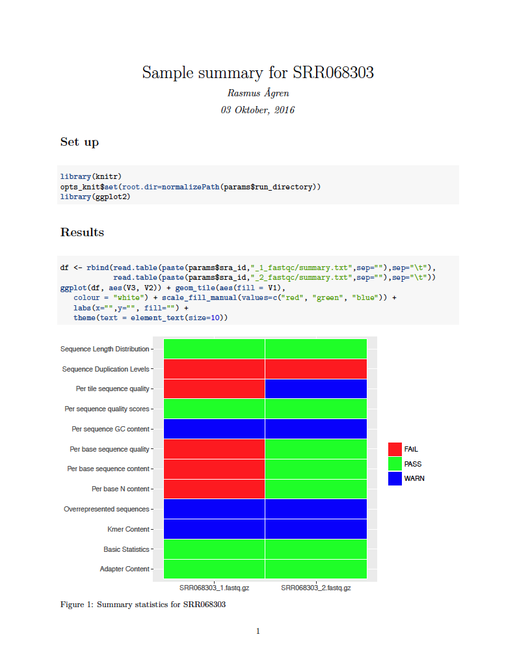
Set up git repository
Set up Conda environment
Define Snakemake workflow
Design Rmarkdown
report
Define Docker image
Push to git
Build, push and run Docker image
$snakemake results/SRR068303.pdf
Provided cores: 1
Rules claiming more threads will be scaled down.
Job counts:
count jobs
2 fastQC
1 get_SRA_by_accession
1 report
rule get_SRA_by_accession:
output: intermediate/SRR068303_1.fastq.gz,
intermediate/SRR068303_2.fastq.gz
1 of 4 steps (25%) done
rule fastQC:
input: intermediate/SRR068303_2.fastq.gz
output: intermediate/SRR068303_2_fastqc.zip
2 of 4 steps (50%) done
rule fastQC:
input: intermediate/SRR068303_1.fastq.gz
output: intermediate/SRR068303_1_fastqc.zip
3 of 4 steps (75%) done
rule report:
input: intermediate/SRR068303_1_fastqc.zip,
intermediate/SRR068303_2_fastqc.zip
output: results/SRR068303.pdf
Removing temporary output file intermediate/SRR068303_2_fastqc.zip. Removing temporary output file intermediate/SRR068303_1_fastqc.zip.
4 of 4 steps (100%) done

Slide 47
Set up git repository
Set up Conda environment
Define Snakemake workflow
Design Rmarkdown
report
Define Docker image
Push to git
Build, push and run Docker image
Dockerfile
FROM rocker/verse
MAINTAINER "Rasmus Agren" rasmus.agren@scilifelab.se
RUN apt-get update && apt-get -y dist-upgrade
RUN apt-get install -y --no-install-recommends bzip2
WORKDIR /home
ENV LC_ALL C
SHELL ["/bin/bash", "-c"]
RUN wget https://repo.continuum.io/miniconda/Miniconda3-latest-Linux-x86_64.sh
RUN bash Miniconda3-latest-Linux-x86_64.sh -bf && rm Miniconda3-latest-Linux-x86_64.sh
ENV PATH="/root/miniconda3/bin:${PATH}"
RUN git clone https://my_user@bitbucket.org/my_user/reproducible_research_example.git
RUN conda config --add channels bioconda
RUN conda create --name my_conda_env snakemake fastqc
CMD source activate my_conda_env;cd reproducible_research;snakemake results/SRR068303.pdf

Slide 48
Set up git repository
Set up Conda environment
Define Snakemake workflow
Design Rmarkdown
report
Define Docker image
Push to git
Build, push and run Docker image
$git add Snakefile Dockerfile conda_env.yml source/sra_report.Rmd
$git commit -m "Added all files"
4 files changed, 97 insertions(+)
$git push
Counting objects: 4, done. Delta compression using up to 8 threads. Compressing objects: 100% (4/4), done. Writing objects: 100% (4/4), 535 bytes | 0 bytes/s, done. Total 4 (delta 2), reused 0 (delta 0) To https://my_user@bitbucket.org/my_user/reproducible_research_example.git 0548a2b..874dffd master -> master

Slide 49
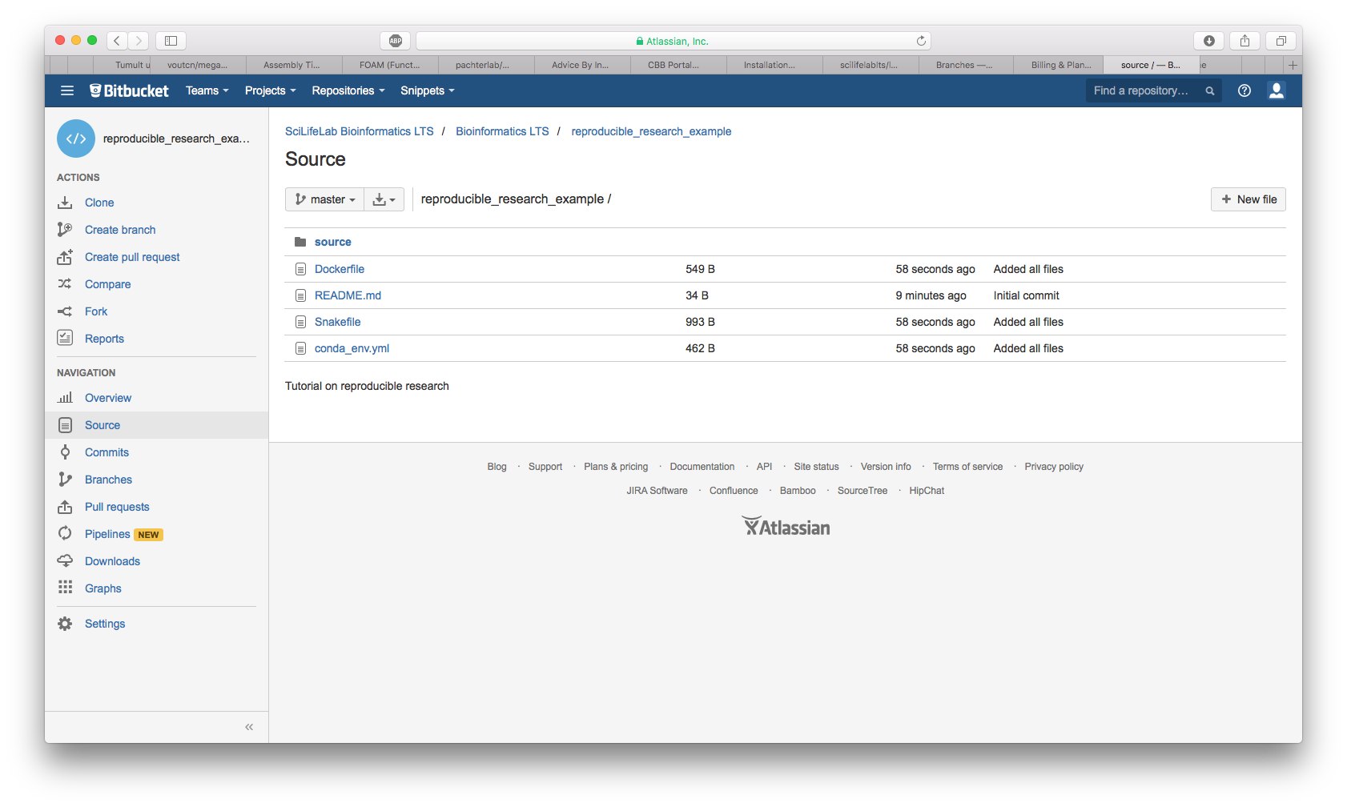
Set up git repository
Set up Conda environment
Define Snakemake workflow
Design Rmarkdown
report
Define Docker image
Push to git
Build, push and run Docker image

Slide 50
Set up git repository
Set up Conda environment
Define Snakemake workflow
Design Rmarkdown
report
Define Docker image
Push to git
Build, push and run Docker image
On your computer
$docker build –t "my_user/reproducible_research_example" .
Sending build context to Docker daemon 448 kB Step 1 : FROM rocker/hadleyverse ---> 456548e98c01
[...]
$docker push my_user/docker_conda
The push refers to a repository [docker.io/my_user/reproducible_research_example] 029a889e84b1: Pushing [> ] 1.109 MB/930.4 MB 8cf203f41737: Pushing [=> ] 4.416 MB/125.3 MB
[...]
$docker run --rm -v $PWD:/home/reproducible_research_example/results \ my_user/reproducible_research_example
Provided cores: 1 Rules claiming more threads will be scaled down. Job counts: count jobs 2 fastQC 1 get_SRA_by_accession 1 report
[...]
$ls
SRR068303.pdf
On someone else’s computer

